Slide 1
MRI Homework2
報告者：王韵雯
日期：2015/11/10

Slide 2
Outline
Software
Equation
Matlab
Python
Conclusion

Slide 3
Software
MATLAB R2012a
ipython-notebook 4.0.4

Slide 4

Equation
$M_{Z,recovery}=M_{z}\left(0\right)e^{{−t}/{T_{1}}}+M_{0}(1−e^{{−t}/{T_{1}}})$
橫向量${=M}_{Z,recovery}\cos{α°}$
縱向量${=M}_{Z,recovery}\sin{α°}$

Slide 5
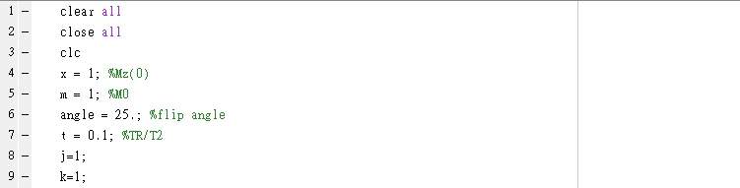
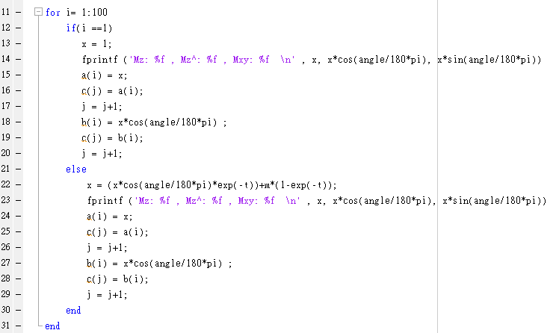
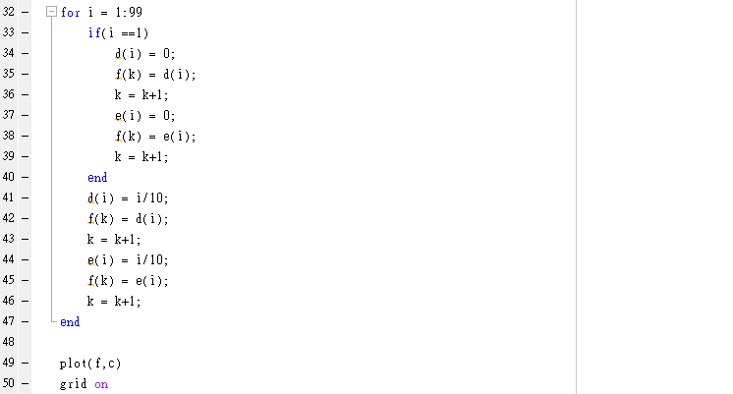
Matlab code

Slide 6
Matlab Result (1)
TR = 0.1T1，Flip angle：25°
Mz: 1.000000 , Mz^: 0.906308 , Mxy: 0.422618
Mz: 0.915224 , Mz^: 0.829474 , Mxy: 0.386790
.
.
.
Mz: 0.528861 , Mz^: 0.479311 , Mxy: 0.223506

Slide 7
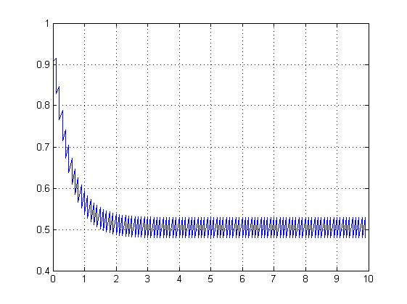
Matlab Result (2)

Slide 8
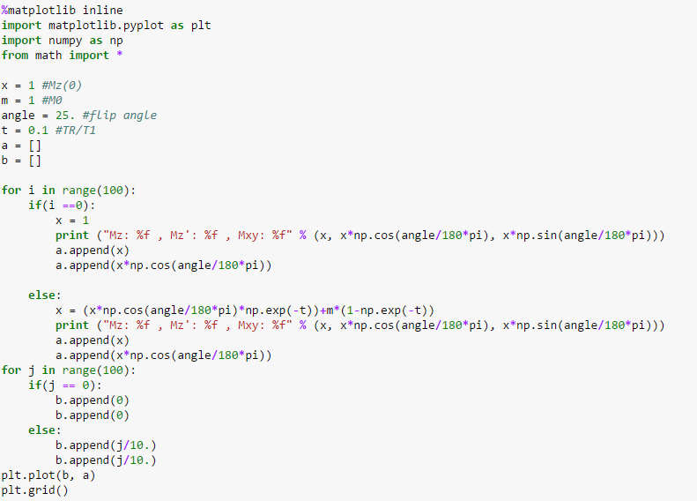
Python code

Slide 9
Python Result (1)
TR = 0.1T1，Flip angle：25°
Mz: 1.000000 , Mz': 0.906308 , Mxy: 0.422618
Mz: 0.915224 , Mz': 0.829474 , Mxy: 0.386790
.
.
.
Mz: 0.528861 , Mz': 0.479311 , Mxy: 0.223506

Slide 10
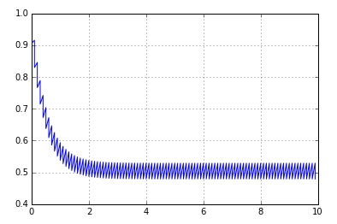
Python Result (2)

Slide 11
Python Result (3)
TR = 0.1T1，Flip angle：90°
Mz: 1.000000 , Mz': 0.000000 , Mxy: 1.000000
Mz: 0.095163 , Mz': 0.000000 , Mxy: 0.095163
.
.
.
Mz: 0.095163 , Mz': 0.000000 , Mxy: 0.095163

Slide 12
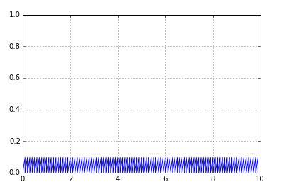
Python Result (4)

Slide 13
Python Result (5)
TR = 0.1T1，Flip angle：50°
Mz: 1.000000 , Mz': 0.642788 , Mxy: 0.766044
Mz: 0.676781 , Mz': 0.435026 , Mxy: 0.518444
.
.
.
Mz: 0.227454 , Mz': 0.146205 , Mxy: 0.174240

Slide 14
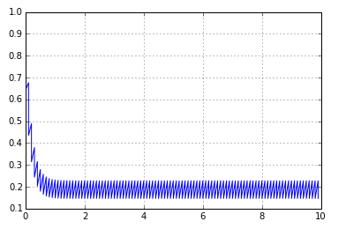
Python Result (6)

Slide 15
Python Result (7)
TR = 0.1T1，Flip angle：10°
Mz: 1.000000 , Mz': 0.984808 , Mxy: 0.173648
Mz: 0.986253 , Mz': 0.971270 , Mxy: 0.171261
.
.
.
Mz: 0.873781 , Mz': 0.860507 , Mxy: 0.151731

Slide 16
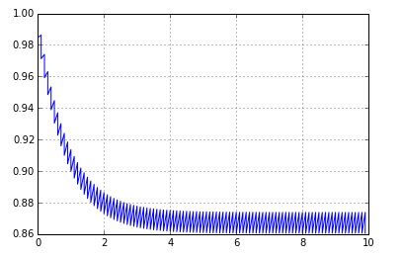
Python Result (8)

Slide 17
Python Result (9)
TR = 1T1，Flip angle：25°
Mz: 1.000000 , Mz': 0.906308 , Mxy: 0.422618
Mz: 0.965533 , Mz': 0.875070 , Mxy: 0.408052
.
.
.
Mz: 0.948293 , Mz': 0.859445 , Mxy: 0.400766

Slide 18
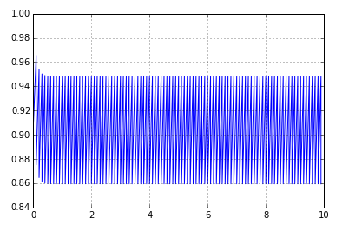
Python Result (10)

Slide 19
Python Result (11)
TR = 10T1，Flip angle：25°
Mz: 1.000000 , Mz': 0.906308 , Mxy: 0.422618
Mz: 0.999996 , Mz': 0.906304 , Mxy: 0.422616
.
.
.
Mz: 0.999996 , Mz': 0.906304 , Mxy: 0.422616

Slide 20
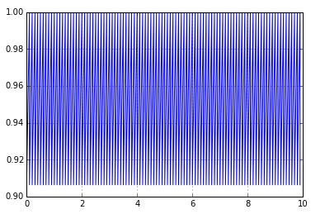
Python Result (12)

Slide 21
Python Result (13)
TR = 0.01T1，Flip angle：25°
Mz: 1.000000 , Mz': 0.906308 , Mxy: 0.422618
Mz: 0.907240 , Mz': 0.822239 , Mxy: 0.383416
.
.
.
Mz: 0.096896 , Mz': 0.087818 , Mxy: 0.040950

Slide 22
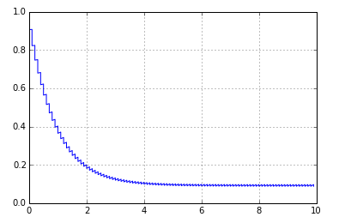
Python Result (14)

Slide 23
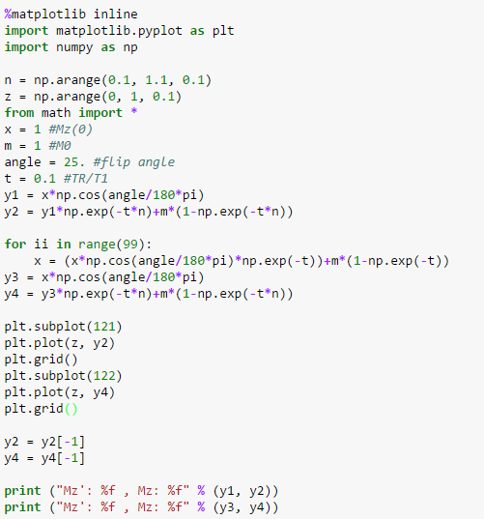
Python code

Slide 24

Python Result (1)
TR = 0.1T1，Flip angle：25°

Slide 25
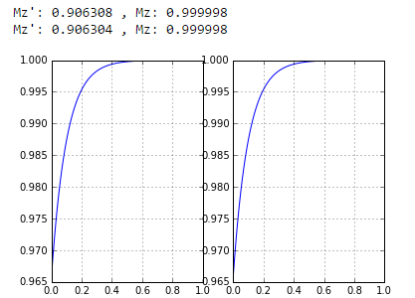
Python Result (2)
TR = 10T1，Flip angle：25°

Slide 26
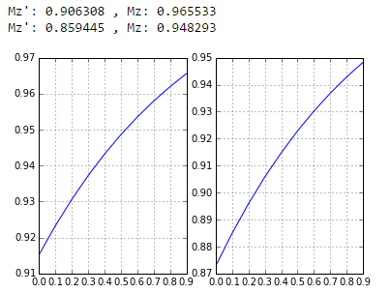
Python Result (3)
TR = 1T1，Flip angle：25°

Slide 27
Conclusion (1)
TR = 0.1T1
Flip angle：10°，熱平衡值：15.1731%
Flip angle：25°，熱平衡值：22.3506%
Flip angle：50°，熱平衡值：17.4240%
Flip angle：90°，熱平衡值： 9.5163%
Flip angle在25°時，熱平衡值有最大值

Slide 28
Conclusion (2)
Flip angle：25°
TR = 0.1T1，熱平衡值：22.3506%
TR = 1T1，熱平衡值：40.0766%
TR = 10T1，熱平衡值：42.2616%
TR = 0.01T1，熱平衡值： 4.0950 %
TR越大，熱平衡值越大，但TR跟T1的比值大於10倍以上，熱平衡值就不太會有變化

Slide 29
The End
Thank you for your attention

